Slide 1

COMP 90049
Knowledge Technologies
Week 10
我们毕业啦
其实是答辩的标题地方
Tutor
Ang Li

Slide 2
Name: Ang Li
E-mail: angl4@student.unimelb.edu.au
Contact information
Research topic: computer vision

Slide 3
Summery
Work through this week’s exercise
Notes:
Secure File Transfer Protocol
Secure Shell

Slide 4
Exercise 1. Revise Support Vector Machines, paying particular attention to the terms “linear separability" and “maximum margin”.
What are “soft margins", and when are they desirable?
Why are we interested in “kernel functions" here?
Why are SVMs “binary classifiers", and how can we extend them to “multi-class classifiers"?

Slide 5
What are “soft margins", and when are they desirable?
Soft margins are when we relax the notion of linear separability. A small number of points are allowed to be on the “wrong" side of the line, if we get a (much) better set of support vectors that way (i.e. with a (much) larger margin).
Sometimes the data is almost linearly separable | if we accept that we probably aren't going to classify every single test instance correctly anyway, we can produce a classier that hopefully generalises better to unseen data.

Slide 6
b) Why are we interested in “kernel functions" here?
The so-called “kernel trick" is often used to transform data.
For Support Vector Machines, sometimes the data isn't linearly separable, but after applying some kind of function | where some useful properties of the data remain (for example, monotonicity of the inner product) --- the data becomes linearly separable. If we do this, we can apply the algorithm as usual.

Slide 7
c) Why are SVMs “binary classifiers", and how can we extend them to “multi-class classifiers"?
either by comparing the instances of one class against the instances of all of the other classes (one-vs-many) and then choosing the most confident prediction, or by considering each pair of classes (one-vs-one) and then choosing the class that comes up the most frequently.

Slide 8
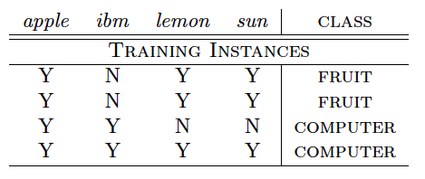
Exercise 2. Build a contingency table for each of the four attributes on the data collection above.
According to “Pointwise Mutual Information", which attribute has the best correlation with the class computer ?

Slide 9
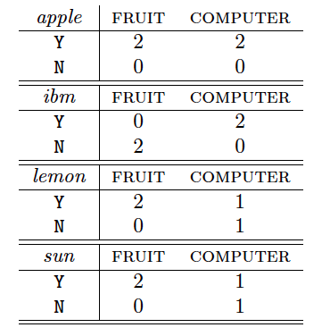
We want four contingency tables: one for each attribute. Notice that the attributes are binary (i.e. Y or N) --- we could do this with numerical data, but our methods of interpreting the probabilities would be different.

Slide 10

Pointwise Mutual Information is calculated according to the following formula (which you can compare with Mutual Information below):

Slide 11
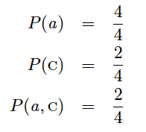
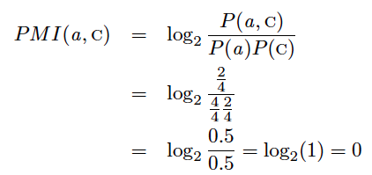
To assess the PMI of apple with computer , we first need to calculate each of the prior probabilities, and the joint probability:
The PMI of apple with respect to the class computer is 0, which means that there is no correlation, and (probably) no predictive capacity.

Slide 12
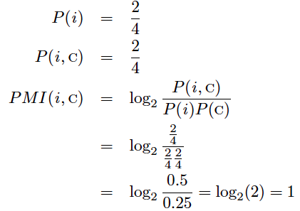

Slide 13
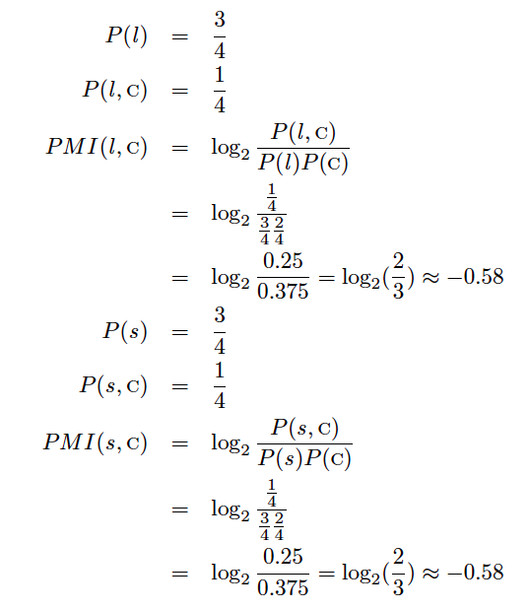

Slide 14
All in all, “ibm” has the greatest Pointwise Mutual Information with the class computer, as we might expect, because they are perfectly correlated.
What if we had found the PMI of fruit instead? Well, in that case, we would have thought that lemon and sun were the best attributes (with a PMI of 0.42).

Slide 15
Exercise 2. Build a contingency table for each of the four attributes on the data collection above.
Use the method of “Mutual Information" to rank the “goodness" of the four features in predicting this two{class problem, according to the following formula:

Slide 16

Use the method of “Mutual Information" to rank the “goodness" of the four features in predicting this two-class problem, according to the following formula:

Slide 17
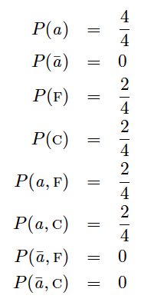
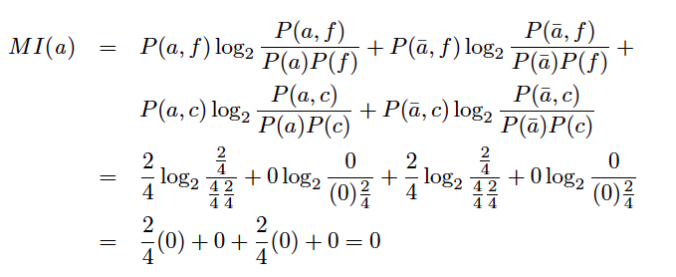
This is very similar to PMI, but we are going to combine the PMIs of the attribute occurring together with each class, as well as not occurring (having a frequency of 0) with each class, weighted by the number of times this has happened.
The value of 0 here means that, regardless of whether apple is present or absent from the instance, it has no predictive power for either of these classes.

Slide 18
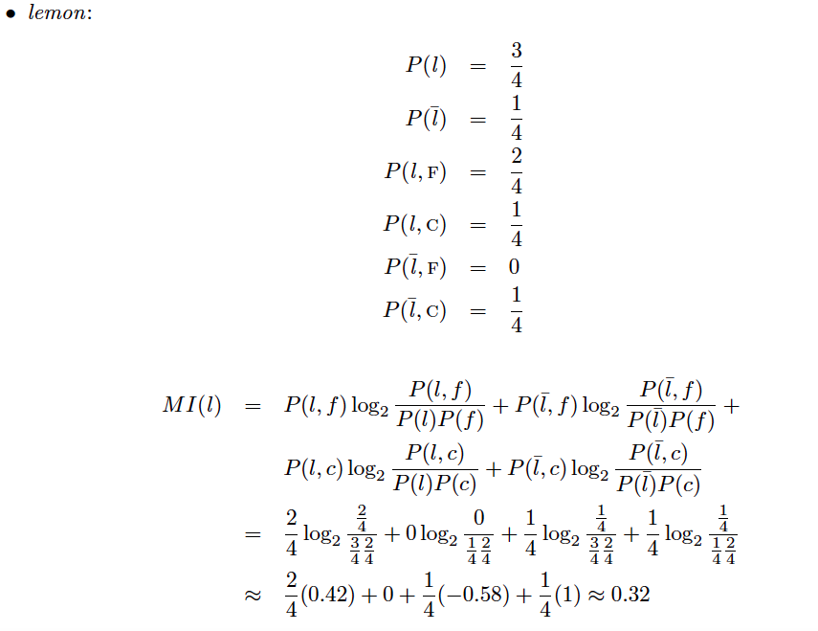

Slide 19
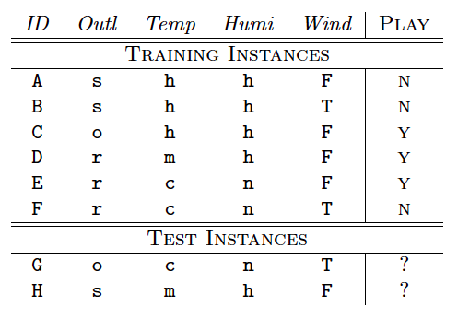
Exercise 3.
Classify the test instances using the method of 0-R.
classify the test instances using the method of 1-R.

Slide 20
Thanks!

